Slide 1
Introductory Session
Programming Fundamentals (PF)
Haroon Zafar
Department of Computer Science,
National University of Computer and Emerging Sciences (NUCES), Peshawar Campus.

Slide 2
Introductory Session
Knowing each other
Some questions you need to answer
Be realistic

Slide 3
Introductory Session
Name
Belonging
Last degree
Marks
Why BS(CS/SE/AI)

Slide 4



Introduction
Haroon Zafar
Lecturer
Recently Joined
Department of Computer Science
National University of computer and emerging sciences (NUCES).
Lecturer
Since Aug 2022-Aug 2023
Department of CS&IT
Sarhad University,
Peshawar, Pakistan
Lecturer
Feb 2021-Jul 2022
Faculty of Computing
Riphah International University,
Islamabad, Pakistan

Slide 5
Introduction (Cont…)
Industrial Experience
Data processing Officer
Pakistan Bureau of Statistics
Android Developer
Aksa-sds

Slide 6
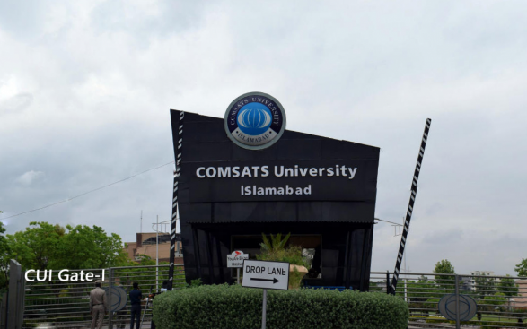
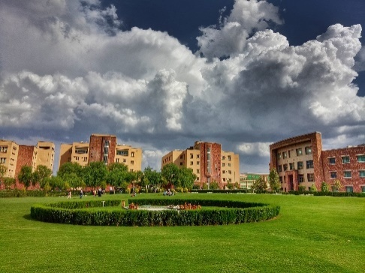
Education
Did my MS from COMSATS University Islamabad (CUI), Islamabad.
Educational back ground
MS(Software Engineering)
BS(Software Engineering)
Major Area Software Engineering

Slide 7
Personal Info
Contact
Office-19 (Academic Block)
Email:
haroon.zafar@nu.edu.pk

Slide 8
Batch Advisor
Batch Fall 2023 (SE/AI)

Slide 9
Course
Course title: Programming Fundamentals
Instructor: Mr. Haroon Zafar
Credit Hours: 4 (3+1)
Semester: Fall 2023
Pre-requisite: Nil

Slide 10
Table of Content (TOC)
All details available in Course Outline uploaded on Google Class room.

Slide 11
Course Structure
Course Work
Lectures
Assignments
Quizes
Project
Some real life application

Slide 12
Recommended Books
Recommended Text Books:
Computer Science: A Structured Programming Approach Using C

Slide 13
Final Words
A Right decision
You need to be specialist is some area of your study.
Programming
Web Development
Networking
Data bases etc
We need to be
Good CS Professional as well as
Good Human-being

Slide 14
THANKYOU!

